Slide 1
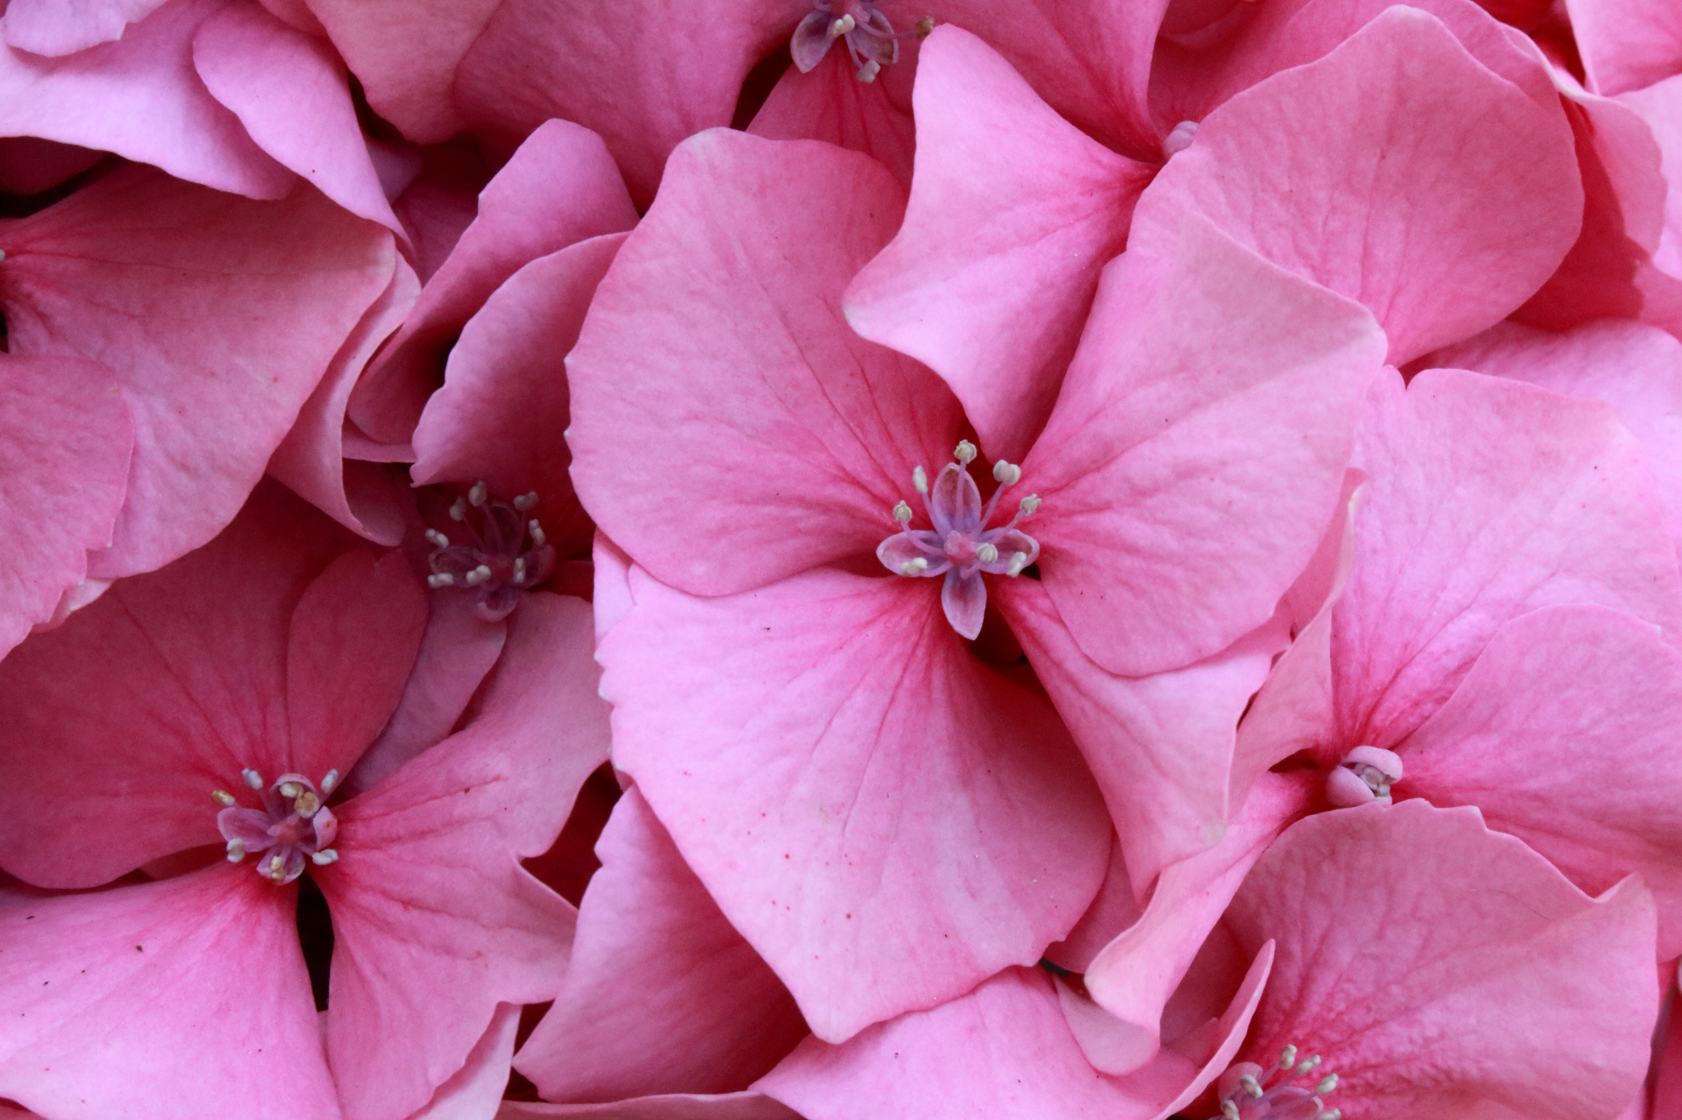



Living things and their habitats
For parents
Thank you for supporting your child’s learning in science.
Before the session:
Please read slide 2 so you know what your child is learning and what you need to get ready.
As an alternative to lined paper, slide 5 may be printed for your child to record on.
During the session:
Share the learning intentions on slide 2.
Support your child with the main activities on slides 3 to 7, as needed.
Slide 8 has optional extra investigations.
Slide 9 has a glossary of key terms.
Reviewing with your child:
Slide 10 gives an idea of what your child may produce.
Introduction to asexual and sexual reproduction in plants
Year 5
Age 9-10

Slide 2
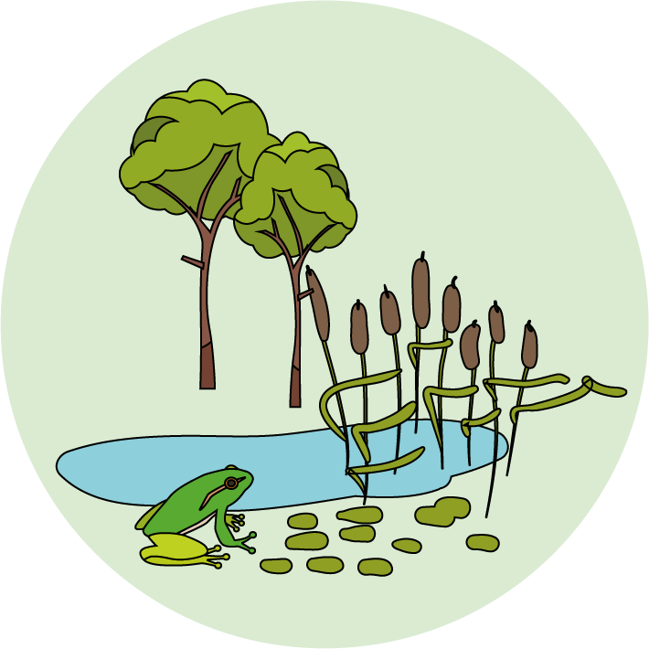

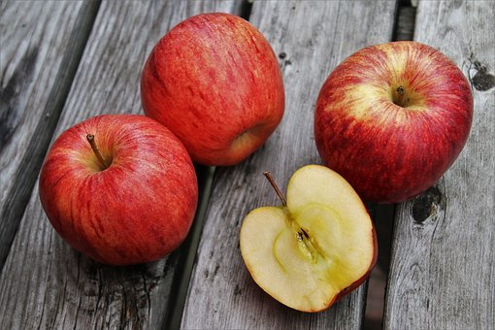
Living things and their habitats
Logo for section to sit inside roundel
Introduction to asexual and sexual reproduction in plants
Key Learning
Plants reproduce both asexually and sexually.
Bulbs, tubers, runners and plantlets are examples of asexual plant reproduction which involves only one parent.
Seeds are formed as part of sexual plant reproduction and are often held in fruits.
Activities (pages 3-7): 40 - 50 mins
Use lined paper, a ruler and a pencil.
Alternatively, print page 7 as a worksheet.
For the practical activity you will need three or four pieces of fruit. See page 7 for suggestions.
Find out more…
You may like to investigate seed patterns or try growing a plant from a cutting.
I can…
explain the difference between sexual and asexual reproduction and give examples of how plants reproduce in both ways.
identify a variety of fruits we eat and compare their seeds.
2

Slide 3
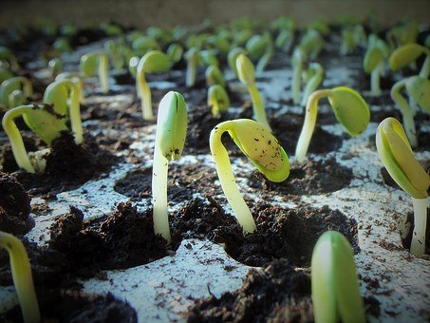
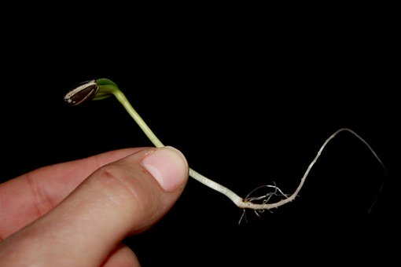
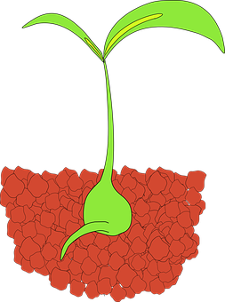
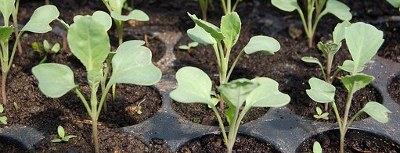
Explore, review, think, talk….
Logo for section to sit inside roundel
What do you already know about the life cycle of a plant?
(5 minutes)
Watch this clip from ‘Explorify’.
https://explorify.wellcome.ac.uk/en/activities/whats-going-on/shooting-sprouts/classroom?view-type=public
Which stage of a plant’s life cycle is shown?
Can you name the parts of the plant?
What do you think will happen next?
Many plants reproduce by developing seeds.
Seeds will germinate provided they have the appropriate conditions, e.g. enough water and warmth. This stage of the life cycle is called germination.
Roots grow first, followed by a shoot with leaves.
3

Slide 4
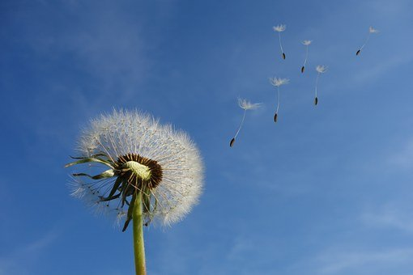
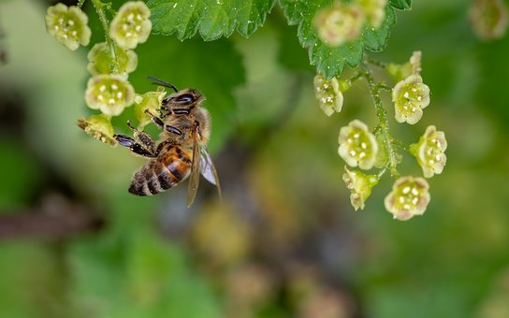
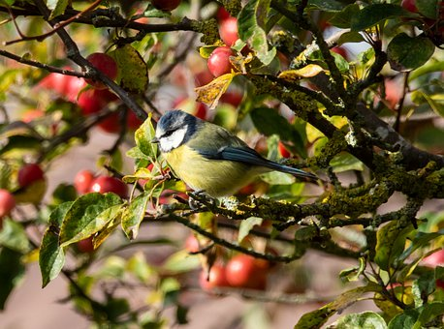
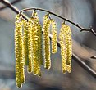
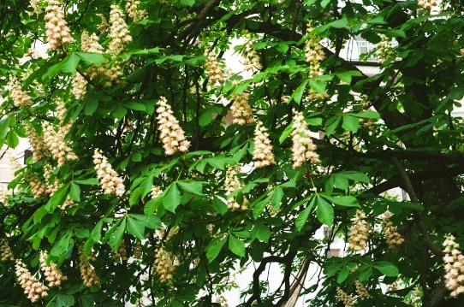
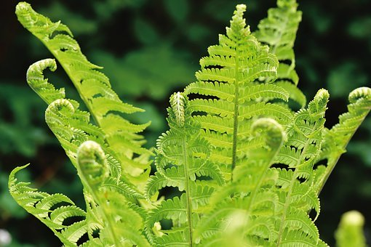
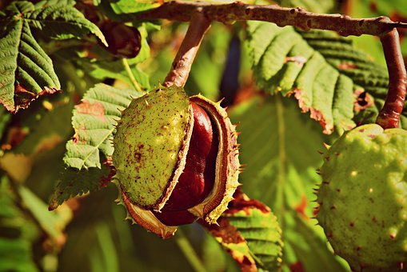
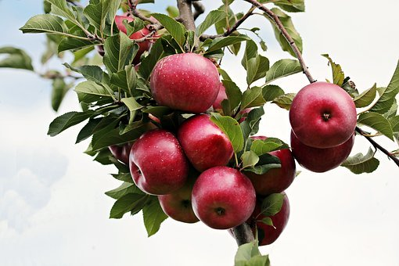
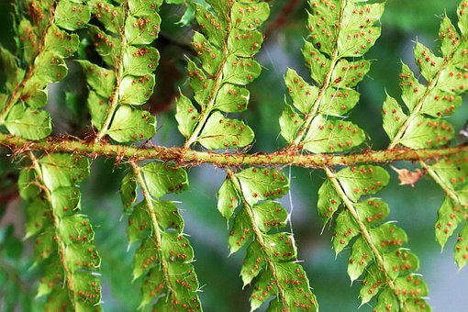
Watch, read, listen…
Logo for section to sit inside roundel
The life cycle of a plant – sexual reproduction
(5-10 minutes)
Read this section of BBC bitesize and watch the video clip.
https://www.bbc.co.uk/bitesize/topics/zgssgk7/articles/zyv3jty
What are the main life cycle stages for a flowering plant?
How are non-flowering plants different?
Flowering plant life cycle
Germination
Seed dispersal
Pollination
Fertilisation and fruit formation
Non-flowering plants like ferns produce spores instead of seeds.
4

Slide 5
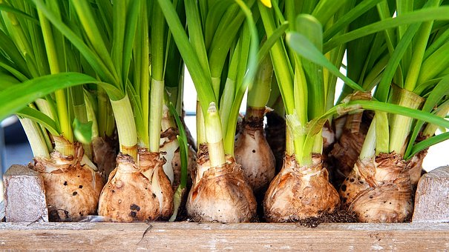
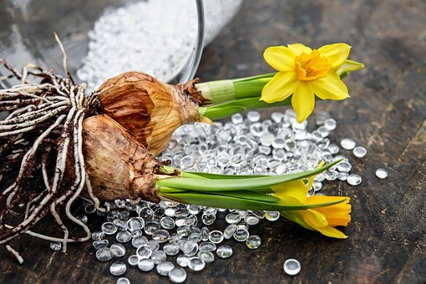
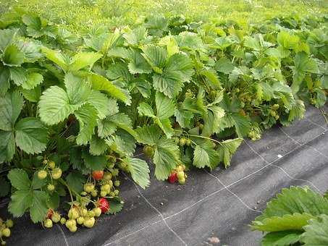
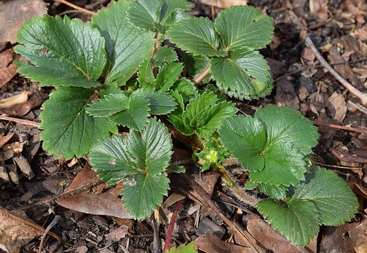
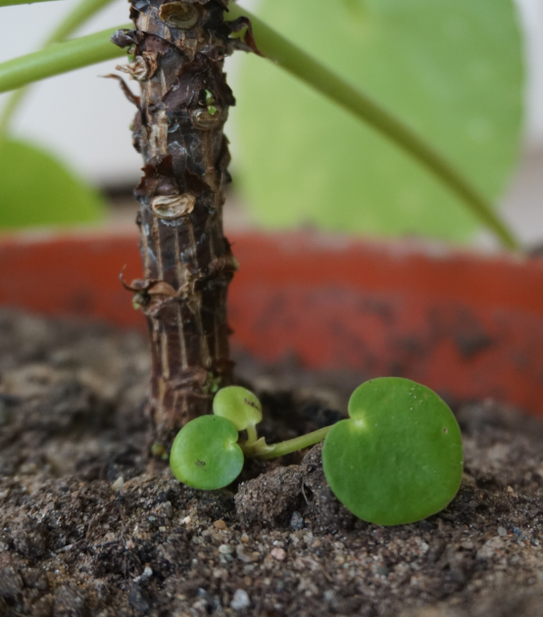
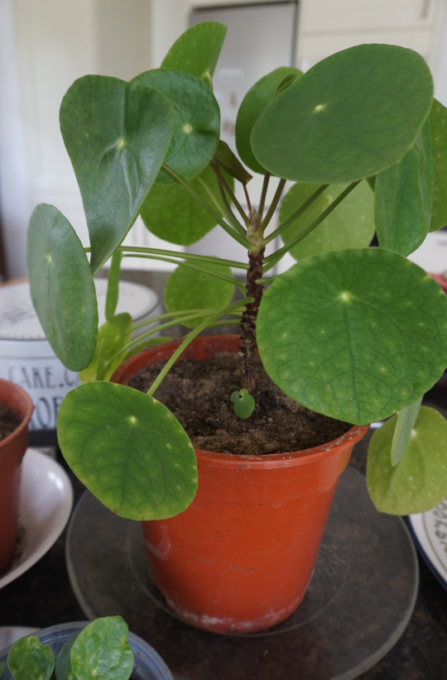
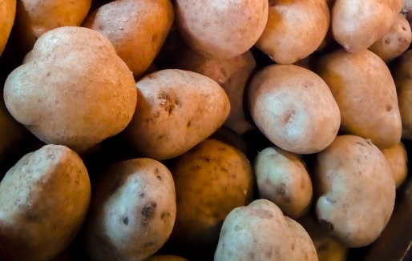
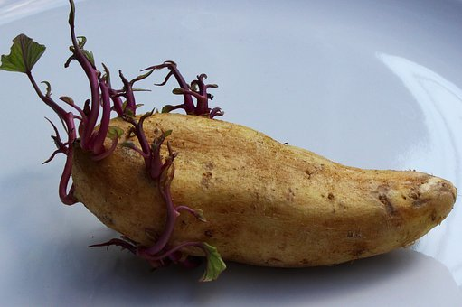
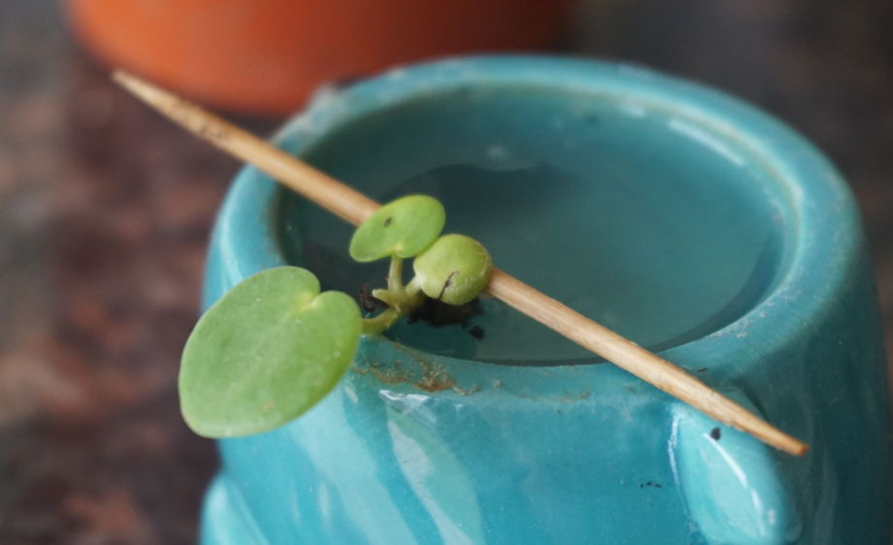
Comparing sexual and asexual reproduction
Logo for section to sit inside roundel
Exploring how plants can reproduce asexually with bulbs, tubers, runners or side shoots
(5 minutes)
Some plants produce an underground food store which develops into next year’s plants. This is asexual reproduction.
Other plants grow sideways runners or side shoots with plantlets which are copies of the parent plant. This is also asexual reproduction.
Bulbs, like daffodils, can form small side bulbs underground which then grow into copies of the parent plant.
Strawberry plants send out sideways runners with plantlets.
Tubers, like potato tubers, form underground and can reproduce asexually to make new plants.
The Chinese money plant forms side shoots which can be cut and grown into a new identical plant.
5

Slide 6
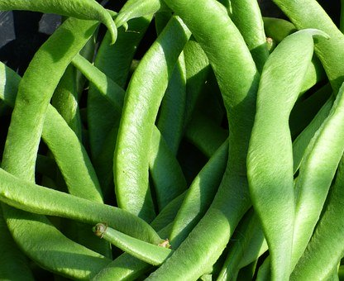
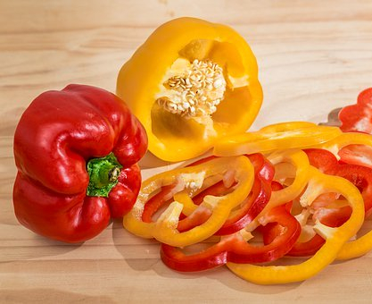
Investigating seeds in some foods we eat
Logo for section to sit inside roundel
Comparing the size, shape and number of seeds in different fruits
(page 5-7: 20-30 minutes)
Food which contains seeds inside are fruits, even though we might think about some of them as vegetables!
Watch this clip. https://www.bbc.co.uk/bitesize/clips/zvypyrd
Now jot down a list of fruits you might find in a supermarket… not forgetting the ones that might be in the ‘vegetable section’!
Investigate some fruit we eat and make a fact file about three or four different fruits. If you need to use a knife to cut the fruit, ask an adult to help you and take care!
Where is the seed found in the fruit?
How many seeds are there in one fruit?
What size, shape and colour is the seed?
Do we usually eat the seed?
You may like to make drawings or take photographs of the fruit and seeds.
Taking it further: You could also draw a bar chart to show the different number of seeds you found in each fruit.
6

Slide 7
Choose any four fruits to make your fact file.
Possible options:
apple, orange, lemon, tomato, green bean, pear, sugar snap pea, avocado, plum, green or red pepper, melon, cucumber…
(Note: Some varieties of fruit are grown as ‘seedless’ like grapes and satsumas.)
I can identify a variety of fruits we eat and compare their seeds.
7

Slide 8
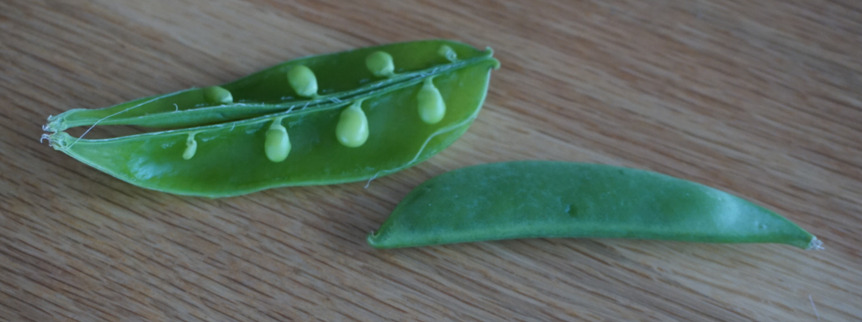
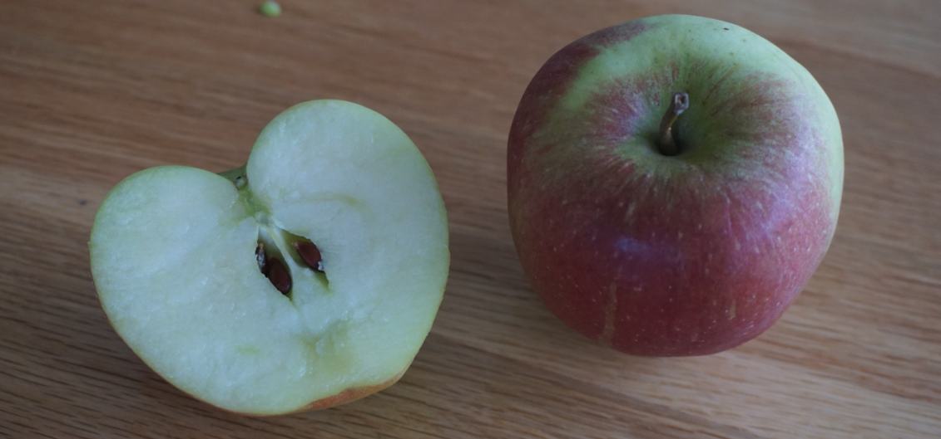
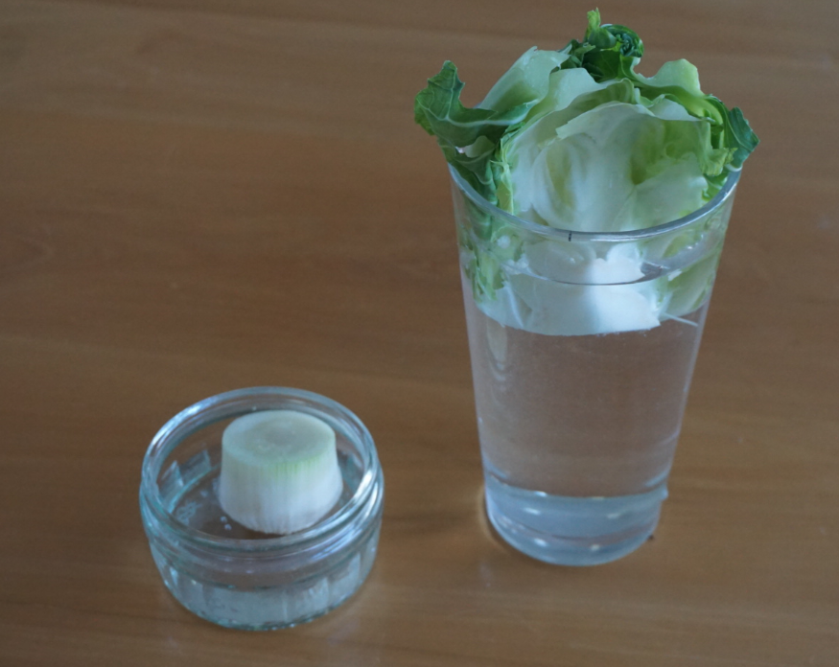
Find out more…
Logo for section to sit inside roundel
You may like to investigate seed patterns or try growing a plant from a cutting.
Do fruits from the same type of plant all have the same number of seeds?
Buy a packet or bag of fruit. Good options include sugar snap peas, green beans or other peas/beans sold in pods. You can also use apples, oranges and pears.
Open each fruit and count the number of seeds inside.
Think about how you will record your results and report your findings.
Can cuttings from vegetables we eat be used to grow new plants?
Save some stalks or ends from some of the vegetables you eat. You might choose lettuce, broccoli, spring onions, leeks, fennel, cauliflower…anything!
Put them in some water in a glass or jar so you can observe any change.
Think about how you will record your observations over two to three weeks.
8

Slide 9
Glossary of terms
Asexual plant reproduction is when a plant reproduces by making a copy of the parent plant.
A bulb is an underground food store. Side bulbs can form to make copies of the parent plant through asexual reproduction. For example, daffodils grow from bulbs.
A tuber is an underground food store. It can make copies of the parent plant through asexual reproduction. For example, a potato is a tuber.
A runner is a side shoot which can grow a plantlet which is a copy of the parent plant. For example, strawberries grow runners.
Sexual plant reproduction is when a plant reproduces by forming seeds or spores.
Germination is when a seed or spore starts to grow into a new plant.
Pollination is when pollen is carried from the male part to the female part of a plant, usually by insects or the wind.
Fertilisation is when pollen fertilises the eggs within the female part of a plant, so seeds can form. The seeds are often contained within a fruit.
9

Slide 10
There are many possible outcomes. This shows an example of four fruits.
Try measuring the largest seed to the nearest millimetre.
Possible learning outcome: I can identify a variety of fruits we eat and compare their seeds.
It is hard to count the seeds for some fruits like the tomato, melon or cucumber. Try spreading them out on a plate and putting the seeds in groups of 10 to make counting easier.
10

